Slide 1



Shreyansh Dwivedi(Team Leader) Md Jishan Devanshu
HOTEL MANAGEMENT SYSTEM
Project Report for Bachelor of Computer Science(SEM-III)

Slide 2

5
1
Introduction
Technology Used
5
Agenda
Objective
Testing Phase
2
6
3
Features
Future Scope
Topics Covered
7
4
E-R Diagram
Conclusion
8

Slide 3



Introduction
The project automates hotel management by handling customer, room, employee data with a user-friendly, secure, desktop-based application.
Desktop-based application with interactive GUI
Provides room booking and staff management
Management of customer, employee, room, and driver records

Slide 4

Objective
To automate hotel management operations
Reduce paperwork and human error
Room booking, room allocation, check-in/out, and payment management
Manage most their work using computerized processes.

Slide 5


Features
Room bookings and reservations
Front desk operations
Guest profile management
Security control and user privileges
Room maintenance tracking

Slide 6
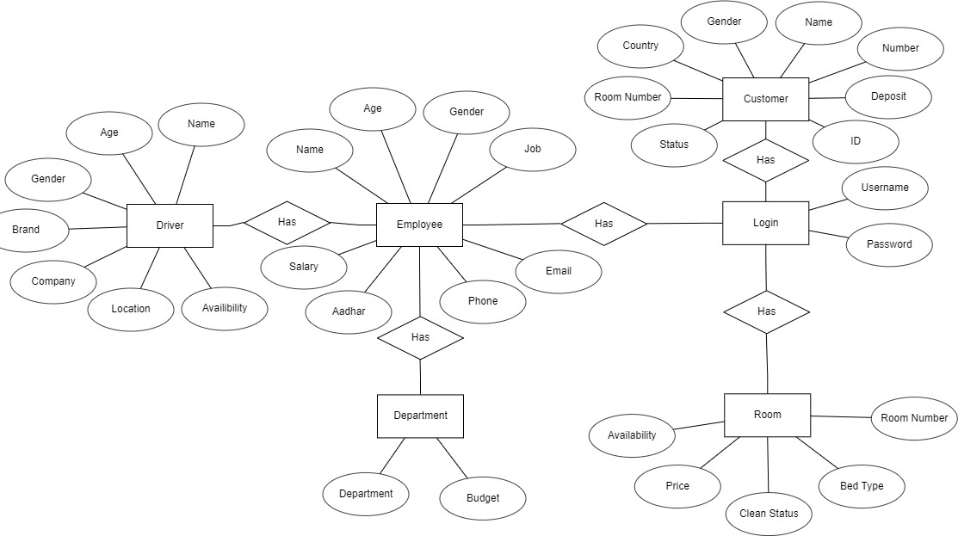
E-R Diagram

Slide 7




Front-end
Java Script, C++, HTML
Back-end
Technology Used
MySQL
User Interface
AWT (Abstract Windowing Toolkit) and Swing.
Operating System
Windows 11

Slide 8
Unit testing
System testing
User acceptance testing
Testing was done for various modules like booking, employee management, etc.
Testing Phase

Slide 9
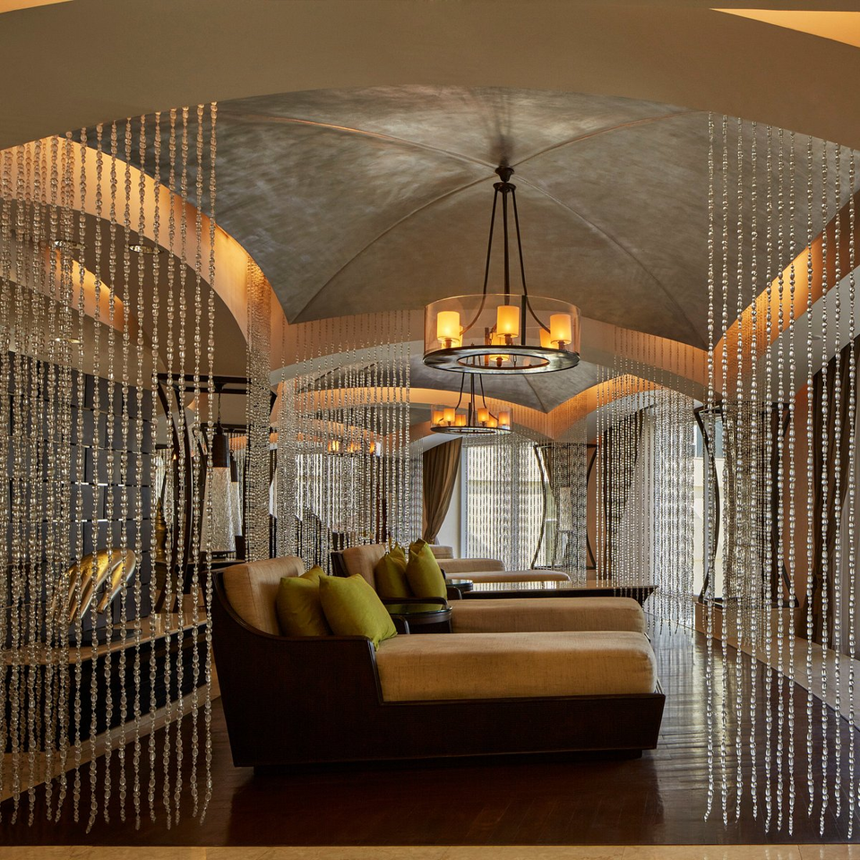










Future Scope
Add more modules like restaurant management, inventory control
Cloud-based integration for better accessibility
Incorporate data analytics for generating insights on booking trends, occupancy rates, and customer preferences.

Slide 10

Successful automation of hotel management tasks
Conclusion
Enhanced efficiency and reduced errors
Acceptance Testing
Integration Testing

Slide 11

Thank you!

